Slide 1
GOVERNMENT COLLEGE OF ENGINEERING SRIRANGAM
DEPARTMENT OF ELECTRRONICS AND COMMUNICATION ENGINEERING
ARTIFICIAL INTELLIGENCE BASED RESUME ANALYZER
DOMAIN : ARTIFICIAL INTELLIGENCE
Presented by
S.HARIHARAN 830121106013
Y.M.KOHILA 830121106020
J.SABITHA SRI 830121106034
K.SENTHIL 830121106039
Under the Guidance of
Dr.R.RANJITH
ASSISTANT PROFESSOR
DEPARTMENT OF ELECTRONICS AND COMMUNICATION
ENGINEERING
GOVERNMENT COLLEGE OF ENGINEERING SRIRANGAM

Slide 2
ABSTRACT
The aim of this project is to design and develop a tool that results into an easy and helpful solution for applicants as well as recruiters.
“AI RESUME ANALYZER” which parses information from a resume using natural language processing, finds the keywords, cluster them onto sectors based on their keywords.
And lastly show the recommendation, prediction, analytics to the applicant / recruiter based on keyword matching.

Slide 3
PRESENT SYSTEM
Traditional hiring involved manual resume screening from newspaper ads and postal applications, making the process slow and inefficient. With industry growth, hiring consultancies emerged, requiring applicants to upload resumes in specific formats for structured data processing. However, the lack of standardization and time-consuming manual screening still pose challenges. To overcome these issues, an automated system is needed to parse, classify, and rank resumes efficiently.
LIMITATIONS:
This is no task for humans and time consuming.
It is challenging task to handle resume manually.
Clashes due to their own unique format.
Requires individual review of each resume from hiring managers.

Slide 4
PROPOSED SYSTEM
The proposed system “AI RESUME ANALYZER” is an applicant cum recruiter-based solution which can be widely used by any organization to analyze and get insights of a resume
The model uses natural language processing to understand the resume and then parse the information from it.
Once information is parsed it is stored in the database.
Quite productive for applicants because it gives predictions, tips and recommendations based on their resume information.
System works proper when the uploaded resume is in traditional chronological format.
Insightful for admin/recruiter due to its powerful analytics and informative data which is fetched from user/applicants resume

Slide 5
HARDWARE REQUIREMENTS
A Laptop / Desktop Connected with Internet.
Minimum of 4GB ram or more.
Single Network Connection.
So that other devices within network can connect through network URL.
SOFTWARE REQUIREMENTS
MySQL
Python
Browser (chrome recommended)
Text Editor (Visual Studio Code recommended)
TECH STACK
1) Frontend HTML5
CSS3
JavaScript
Streamlit
2) Backend
Python
JSON
3) Database
MySQL
Python
JSON

Slide 6
SYSTEM DESIGN – MODULO DIVISION
This tool deals with three modules based on the working.
Client: -
1. Fetching Location and Time Stamp Data
2. Using Parsing Techniques to fetch
Basic Info
Skills
Keywords
3. Using logical programs, it will recommend
Skills that can be added Predicted job role
Course and certificates Resume tips and ideas
Overall Score
Interview & Resume tip videos

Slide 7
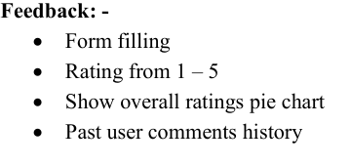
SYSTEM DESIGN – MODULO DIVISION
Admin: -
Get all applicant’s data into tabular format
Download user’s data into csv file
View all saved uploaded pdf in Uploaded Resume folder
Get user feedback and ratings
Pie Charts for: -
Ratings
Predicted field / roles
Experience level
Resume score
User count
City
State
Country

Slide 8
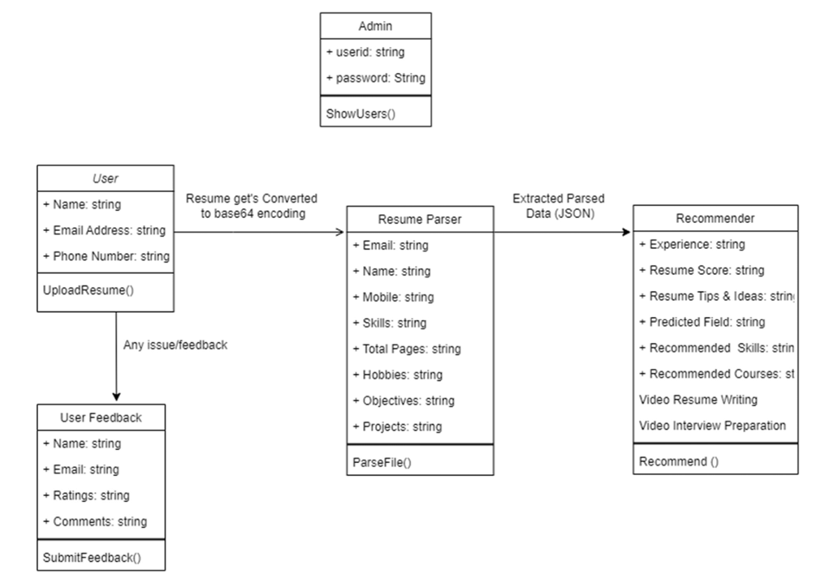
CLASS DIAGRAM

Slide 9
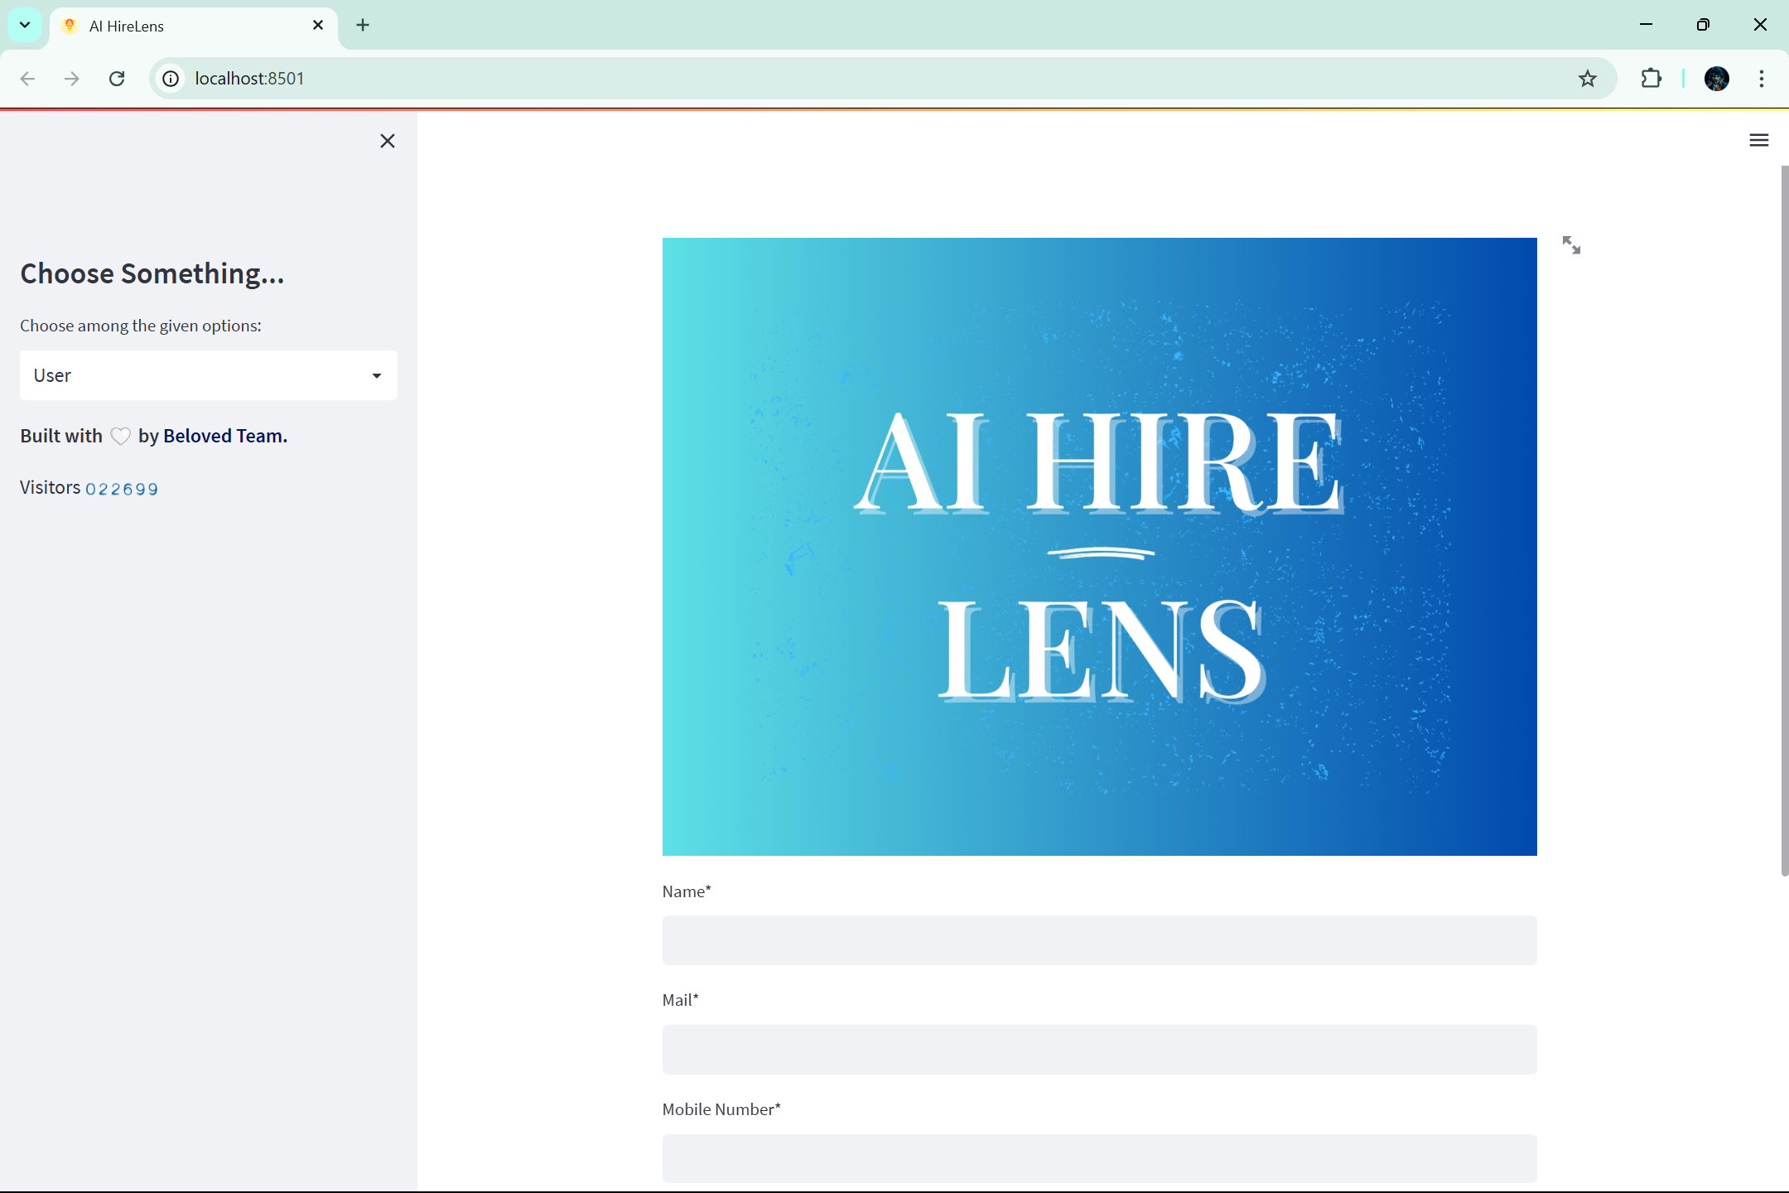
RESULTS
USER PAGE

Slide 10
THANK YOU

